Slide 1

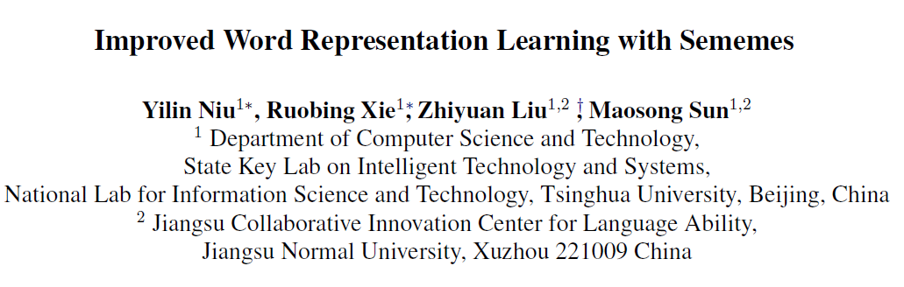

Slide 2
Abstract
Sememes (义原) are minimum semantic units of word meanings, and the meaning of each word sense is typically composed by several sememes. Since sememes are not explicit for each word, people manually annotate word sememes and form linguistic common-sense knowledge bases.
In this paper, we present that, word sememe information can improve word representation learning, which maps words into a low-dimensional semantic space and serves as a fundamental step for many NLP tasks.

Slide 3
Contribution
To the best of our knowledge, this is the first work to utilize sememes in HowNet to improve word representation learning.
We successfully apply the attention scheme to detect word senses and learn representations according to contexts with the favor of the sememe annotation in HowNet.
We conduct extensive experiments and verify the effectiveness of incorporating word sememes for improved WRL.

Slide 4

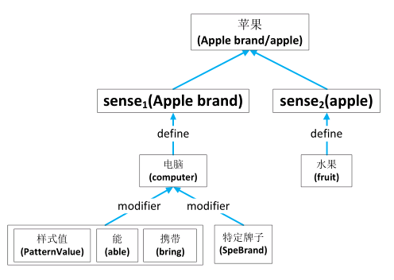
HowNet

Slide 5
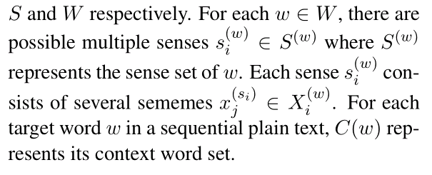
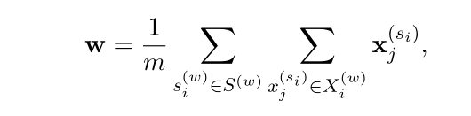
Simple Sememe Aggregation

Slide 6
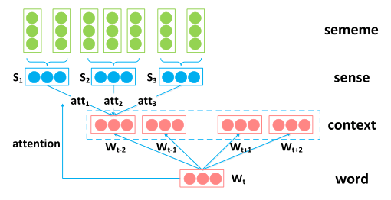
Sememe Attention over Context

Slide 7
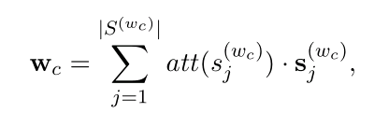
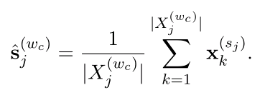
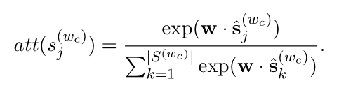
Word embeddings for target words
Sememe embeddings for context words

Slide 8
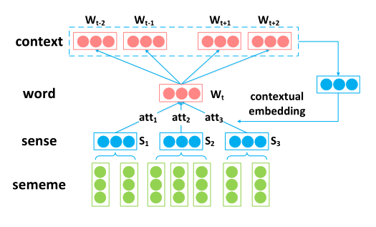
Sememe Attention over Target

Slide 9
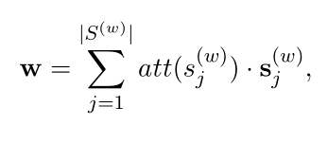
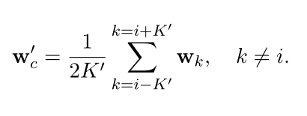
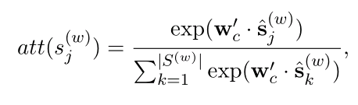
Word embeddings for context words
Sememe embeddings for target words

Slide 10
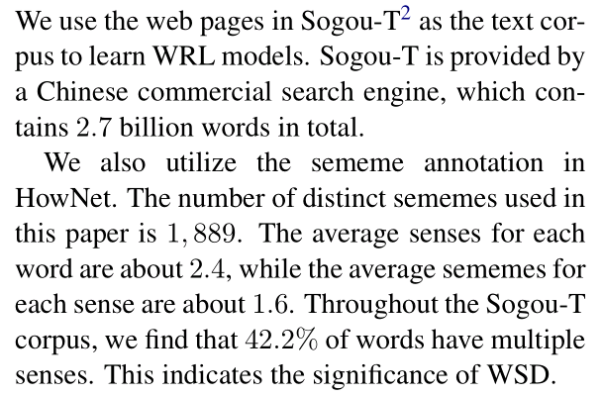
Dataset

Slide 11
MST
It represents the current word embeddings with only the most probable sense according to the contexts, instead of viewing a word as a particular distribution over all its senses similar to that of SAT.

Slide 12
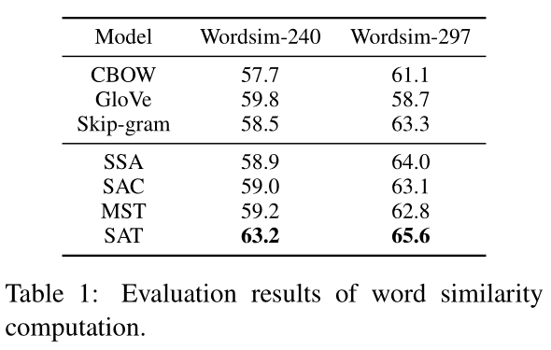

Slide 13
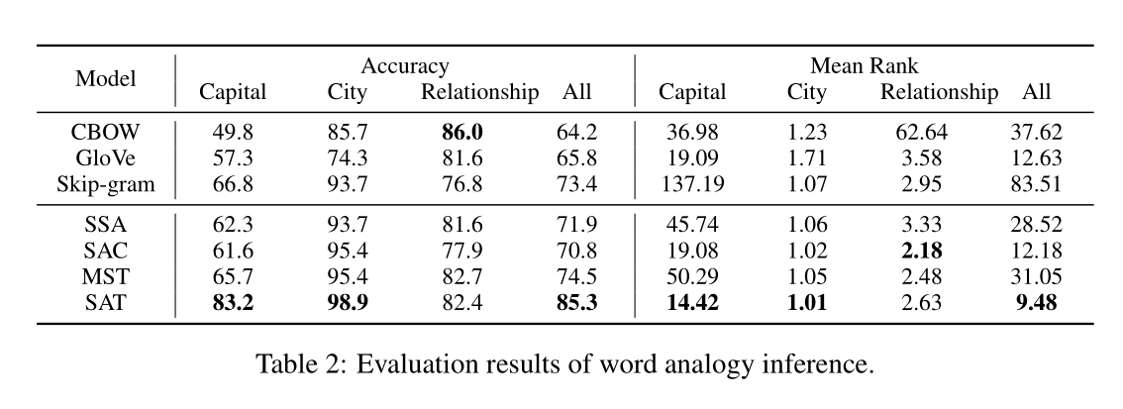

Slide 14

Word analogy
雅典 希腊 北京 中国
东京 日本 曼谷 泰国
广州 广东 济南 山东

Slide 15
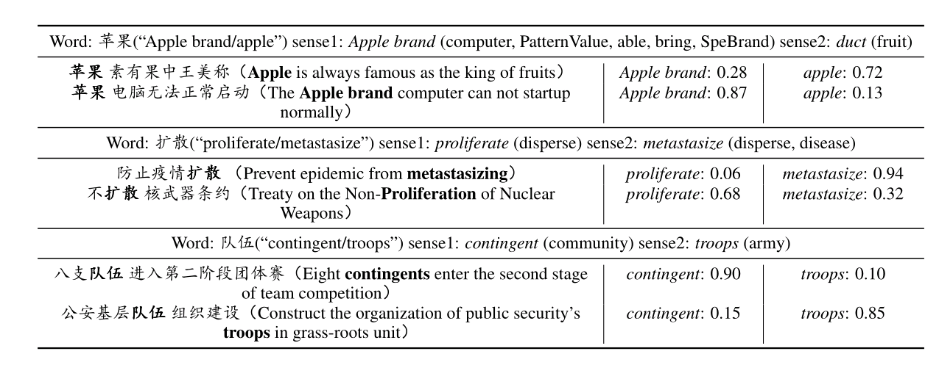

Slide 16
